Slide 1
“Digitalized Manufacturing and Industrial Automation based on 5G – Challenges and expected applications” Presenter: Assoc. Professor Dimitris Mourtzis Laboratory for Manufacturing Systems & Automation (LMS) Dept. of Mechanical Engineering & Aeronautics University of Patras, Greece www.lms.mech.upatras.gr

Slide 2
Agenda
1
Agenda
2
5G Introduction
3
5G Applications
4
5G Challenges
5
Summary & Outlook

Slide 3
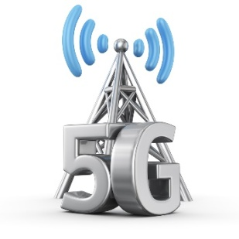
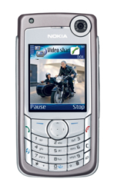
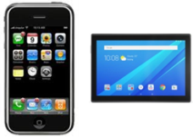
5G Wireless Technology: Evolution from 1G to 5G
The generation of Connectivity
Evolution & Revolution
Revolution
Analog- Digital
Evolution
Integration of Data Services (mobile Web)
Evolution
Everything IP- based + higher Data speeds
Integration of vertical industries
1G
2G
3G
4G
Control &
Management
(Machine type communication, IoT + AR, VR, Ambient Assistant Living)
Analog voice Services
(car phone)
Digital voice services + SMS texting
(globally available)
Voice + data
(call- based + packet based)
IP Data
(voice, e-mail, web, audio/ video streaming)
2kbps
14-64 kbps
2 Mbps
200 Mbps
>1 Gbps
GSM
GPRS
UMTS
HSPA
LTE
LTE Advanced
EDGE
HSPA+

Slide 4
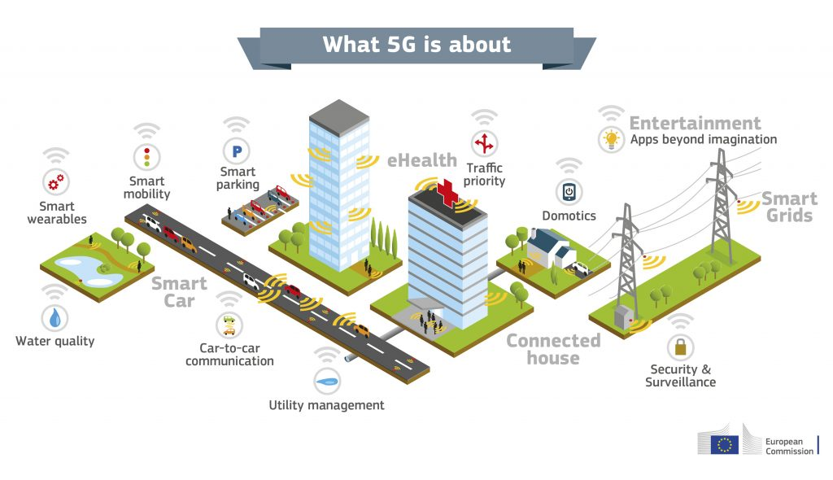
Introduction: What is 5G and what is about ?
5G technology: 5th generation of wireless networks which was started from late 2010s
5G will provide great improvement in performance in the areas of more capacity, more mobility, lower latency and higher reliability and availability.
[EU, 2016]

Slide 5
How close to 5G are we in Greece?
4G networks appeared in Greece in 2012
At the end of 2016, we estimate that 15% of users subscribed to a 4G network
4G will become the technology with the most subscribers in 2020, while by the end of 2022 subscribers to 4G networks will quadruple compared to 2016.
In Greece less than 10 % of homes can already subscribe to FTTP services
The worst performing countries include Cyprus, Greece, Croatia, Italy and France with speeds of less than 10 Mbps.
National Broadband Plans (NBP)
100 % coverage with 30 Mbps by 2020.
50 % HH penetration with 100 Mbps by 2020
It is estimated that in 2021 there will be 5G networks in Greece
[Digital Economy and Society Index (DESI) 2017 ranking]

Slide 6
How close to 5G are we in Greece? - Digital Economy and Society Index (DESI)
The Digital Economy and Society Index (DESI) is a composite index that summarizes relevant indicators on Europe’s digital performance and tracks the progress of EU Member States in digital competitiveness.
The five dimensions of the DESI
Romania, Bulgaria, Greece and Italy have the lowest
scores on the index.
Connectivity
Human Capital
Integration of Digital Technology
Business digitisation and eCommerce
Digital Public Services
eGovernment
Fixed Broadband, Mobile Broadband, Broadband speed and prices
Basic Skills and Internet Use, Advanced skills and Development
Use of Internet
Citizens' use of Content, Communication and Online Transactions
[Digital Economy and Society Index (DESI) 2017 ranking]

Slide 7
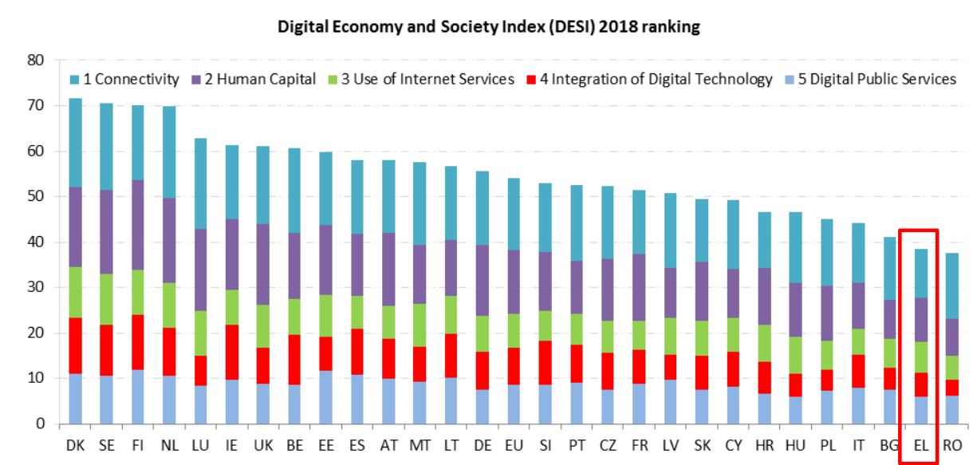
How close to 5G are we in Greece? - Digital Economy and Society Index (DESI)
[Digital Economy and Society Index (DESI) 2017 ranking]

Slide 8
How close to 5G are we in Greece? – 5G Pilot Cities
Greece selects Patras as the other pilot city for 5G
Greece selects Trikala as first 5G city
Agreement on the creation of a cross-border corridor between Greece and Bulgaria and Serbia for connected and automated mobility.
Digital Assembly 2018

Slide 9
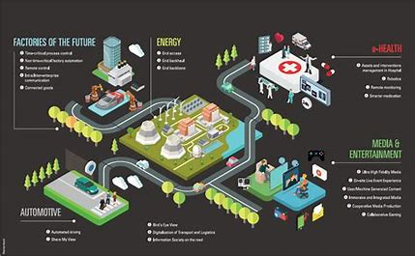
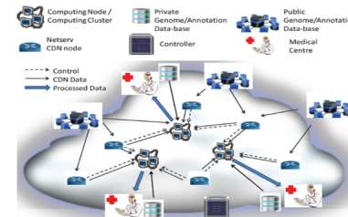
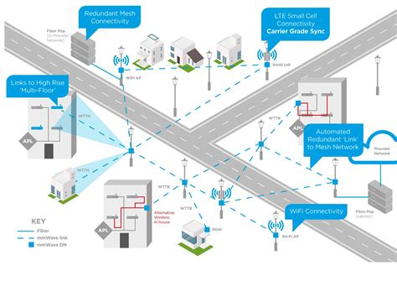
5G will revolutionize 5 key industries - Applications
TV and media
Manufacturing
Healthcare
Telecommunications
Transportation and infrastructure
[451 Research, 2016]

Slide 10
Telecommunications
5G will revolutionize 5 key industries - Applications
[NOKIA 2014]
10.000 x more traffic
10-100 x more devices
↓ 1 millisecond latency
100 Mbit/s whenever needed
Ultra reliability
↑ 10 Gbips peak data rates
Low energy
M2M ultra low cost
10 years M2M battery life

Slide 11
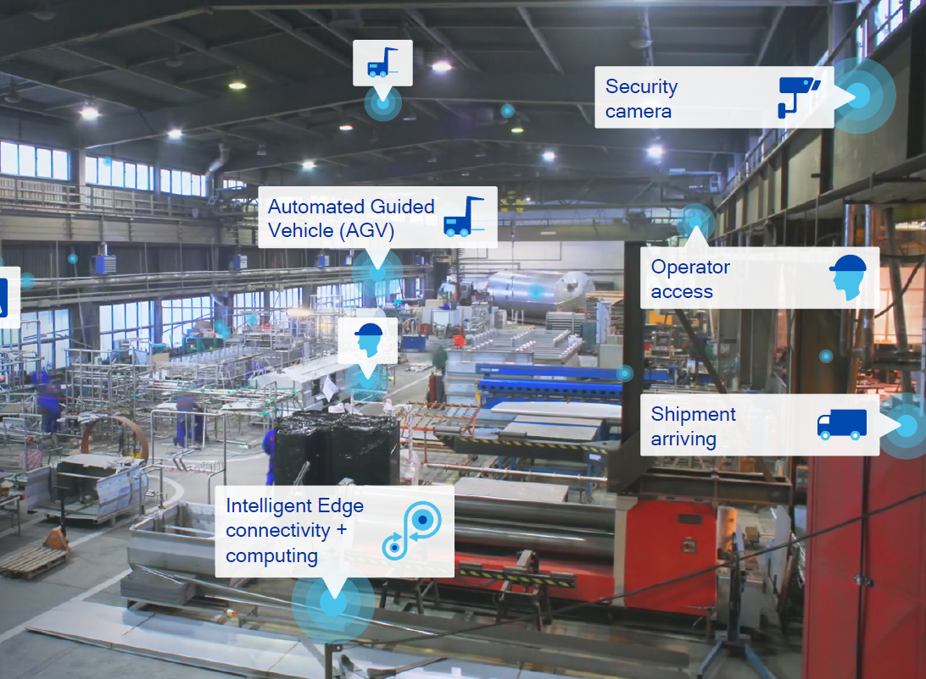
Manufacturing
5G Applications – Digitalized Manufacturing
[ERICSSON 5G USE CASES]
New service capabilities for industrial stakeholders thanks to the unprecedented on-demand performance and real-time reactivity.
http://enterprise-iot.org/book/enterprise-iot/part-i/manufacturing/

Slide 12
Healthcare
5G Applications – Healthcare
[ERICSSON 5G USE CASES]
5G will become the backbone of IoT, connecting devices in ways we never thought possible.
Only a “small minority”, around 5% of patients, are equipped with connected medical devices.
93% of doctors believe that connected devices can help prevent health risks such as obesity, diabetes and high blood pressure.
Remote check up
Blood pressure or insulin body worn sensors
High node/service availability at least 99.999% node availability
50% of doctors think that the devices pose a threat to medical confidentiality.
When thinking about new 5G capabilities in the domain of lower latency, reaching the target of 1 millisecond, we could even think of applications in the area of prosthesis or augmented human.

Slide 13
Transportation and infrastructure
5G will revolutionize 5 key industries - Applications
[ERICSSON 5G USE CASES]
When transportation and vehicles are equipped with 5G connectivity, it will revolutionize the way we travel.
Sensors embedded in roads, railways and airfields to communicate to each other and/or with smart vehicles.
Vehicle-to-vehicle and vehicle-to-infrastructure communication will make roads safer and more environmentally friendly.
New services and business models
Users will experience smart cars that are capable of communicating with traffic lights
5G technology brings:
Sustainability
Safety
Fleet monitoring
Navigation & augmented reality
Eco-system scalability
Opportunity areas
Autonomous vehicles
Connected bus-stops
Connected trucks
Connected cars

Slide 14
TV and media
5G will revolutionize 5 key industries - Applications
[ERICSSON 5G USE CASES]
Users will be able to communicate in crowded or remote areas with lightning fast broadband.
4K movies downloaded in just seconds without a Wi-Fi connection.
Broadband access in crowded areas like concerts, sporting events and festivals, alleviating issues with capacity, interference and reliability.
Media will truly become on-demand from any location and any device.
Augmented reality and 360 degree immersive gaming and movies
Opportunity areas
Mobile broadband evolution
On-demand anything
Events platform
Live TV at scale
5G will also maximize their experience in both indoor and outdoor connectivity and offer high QoS broadband even in challenging network conditions.

Slide 15
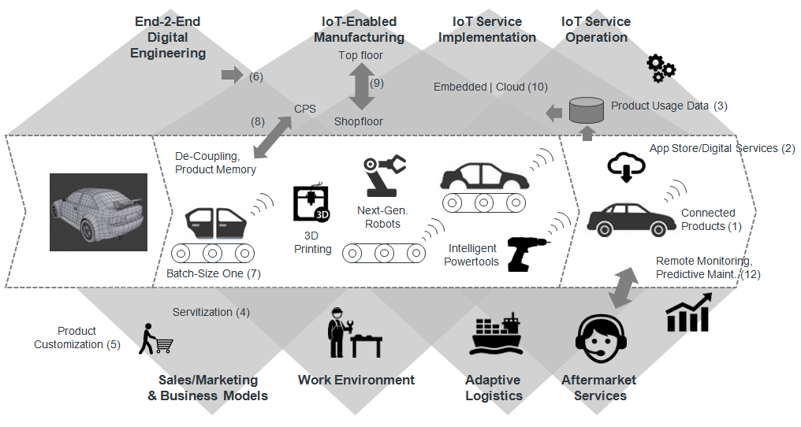
5G Applications – Digitalized Manufacturing
http://enterprise-iot.org/book/enterprise-iot/part-i/manufacturing/

Slide 16
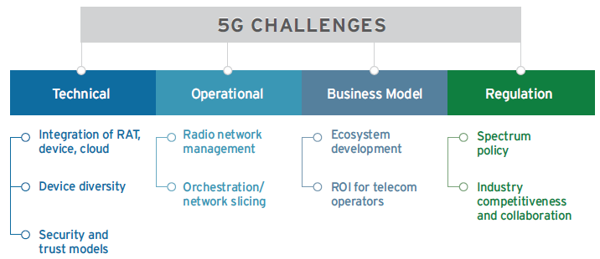
5G Challenges
INDUSTRY MUST
TACKLE 5G CHALLENGES
[451 Research, 2016}

Slide 17
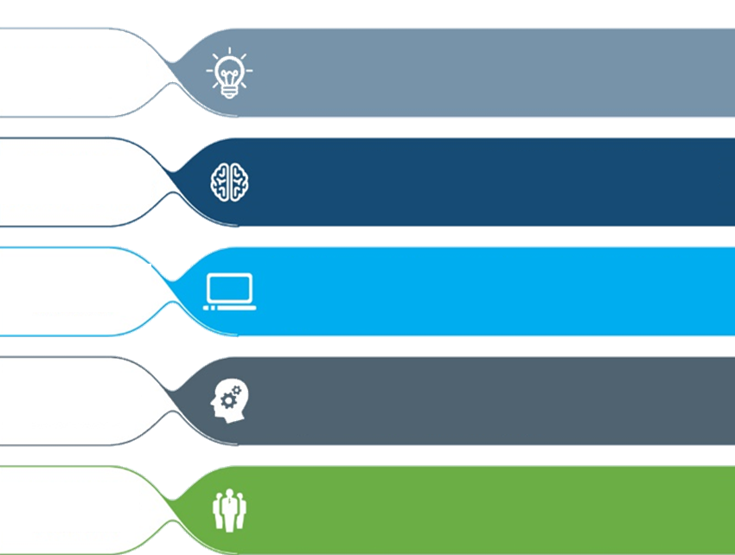
5G Wireless Technology: Challenges
Massive throughput
Massive low latency
New business models focused on vertical markets
Spectrum harmonization
Massive sensing
Increasingly small cells
Massive resilience
Massive safety and security
Massive fractal heterogeneity
Net neutrality issues

Slide 18
5G Wireless Technology: Challenges
IoT and number of connections
Data volumes
Increasing capacity without increasing cost
Fast and flexible deployment architecture
Real-time information for critical services
Coping with augmented reality
M2M and automotive
Device-to-device
Air interface
Network densification
[Anritsu envision:ensure]

Slide 19
Opportunities
Summary & Outlook
Virtual Reality
Secure distributed computing
Artificial Intelligence
Big Data analytics
Augmented Reality
Compute convergence
Data services diversity
Challenges
5G will bring:
Amazing Volume amazingly fast
Massive amount of connected things & people
Energy Efficiency
Always best connected
No perceived delay
Flexible programmable networks
Secure networks
Network densification
Network slicing
Future Demands
Enabler5G!
Keep your eyes focused on the future prospect of the world enabled by 5G and be a part of it!

Slide 20
THANK YOU!
For more information:
Professor Dimitris Mourtzis
{ mourtzis@lms.mech.upatras.gr}
Laboratory for Manufacturing Systems & Automation (LMS)
Dept. of Mechanical Engineering & Aeronautics
University of Patras, Greece
www.lms.mech.upatras.gr

